Slide 1


An Introduction to World Civilizations: An Overview of the Course
Dr. Faruk Shah
Associate Professor
Department of Development Studies
University of Dhaka
&
Adjunct Faculty Member
Department of History and Philosophy
North South University

Slide 2
Course Objectives:
To understand the historical progress of human civilizations.
To explore the significant instruments of cultural progress.
To identify the impacts of innovation and inventions on human society of the course of history.
To comprehend the importance of significant events in the history of the development of human society with subjective analytical interpretations.
To build the capacity of the students to relate objective understandings with subjective cultural traits all around the world to get a better understanding of human nature.

Slide 3
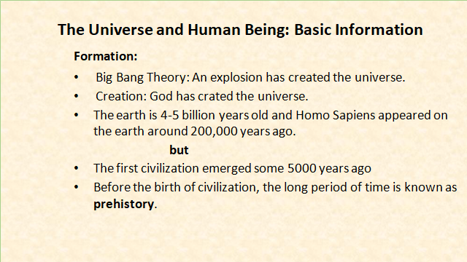

Slide 4
Introduction to Civilization
Meaning and Features of Civilization
Core Concepts Related to Civilization
Origin and Development of Civilization: Contexts and Theories
Major Civilizations in Human History
Importance of Studying the History of Civilization
Interrelationship between Culture & Civilization

Slide 5
Understanding Culture
Definition, patterns & characteristics of culture
Functions & significance of culture
Key terms related to culture
Development of culture
(stages of social evolution: savagery-barbarism-civilization)
V. Mechanisms of cultural change

Slide 6
Mesopotamian Civilization
The beginning of civilization: Geography
Emergence of city-states
Life in the city-states
Social structure
Women status
Rulers and polity: government and law
Trade
The evolution of writing
Religion

Slide 7
Egyptian Civilization
Geography
Early stages of Egyptian civilization
Rulers: political system
Social organization: family
Gender relation
Religion
Economic system: Agriculture
Education system
Science and medicine

Slide 8
Indus Valley Civilization
Geography
A planned urban city
Sites, artifacts, scripts and seals
Culture & society: occupational groups & caste system
Religion and government
Subsistence patterns: agriculture & trade
Daily life and position of women: purdah & satidaho
Decline of settlements

Slide 9
My Civilization???
Brahmaputra Civilization: Wari-Batteswar in Bangladesh

Slide 10
Chinese Civilization
Geography
Social and political life
Economy
Irrigation system (hoang ho) and natural resources
Chinese arts, science and technology
Religion

Slide 11
Greek Civilization
Geography
Religion and city-states
Early concepts of democracy
Greek life styles
Greek drama and literature
Home and marketplace
Shaping New Views of the World

Slide 12
Roman Civilization
Geography
Roman Republic and Empire
Roman law
Roman buildings, designs and construction techniques
Civilizations under Holy Roman Empire
Roman family and women: extended family & higher reproduction
Roman education
Science and technology

Slide 13
Muslim Civilization
Geography
History
Government system
Communication system and trade
Religious beliefs and practices
Impact of Muslim culture

Slide 14
Slavery and Feudalism in Europe
Defining slavery
Slavery in Greece and Rome
Understanding feudalism
Origin of feudalism
Lord-vassal relation
Social class in European Feudal system

Slide 15
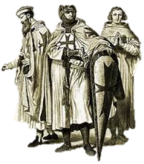
Crusade and Its Impact over Modernity
A crusade was a “Holy War” between European Christians and Muslims.

Slide 16
The Rise of Trade and Towns
&
Medieval Education: Growth of Universities
Background of university education
Famous universities in Medieval Europe
Education system
Education equipments and facilities
Importance of university

Slide 17
Renaissance and Reformation
Meaning and spirits of renaissance
The political and economic structures of different Italian city-states
The religious reformation of Renaissance period
The development of Humanism in forms of art
The technological, philosophical, ideological and literary contributions of Renaissance

Slide 18

Scientific Revolution---The Age of Enlightenment: Reason & Reform

Slide 19
Industrial and Post-Industrial Revolution
Meaning and elements of industrial revolution
Beginning of the industrial revolution
The rise of modern industry
Effects of industrialization
Response to industrial revolution
Post-industrial revolution

Slide 20
Geographical Discovery and Colonialism
The Age of Enlightenment and reformations
French & American revolution
The Rise of Modern Nation states

Slide 21
CRISIS AND SOLUTION in 21st Century……
The Clash of Civilizations
Sustainable society
Better WORLD

Slide 22
Assessments Criteria (100 marks)
Attendance and class participation (10)
Class Test/Quiz (20)
Mid-term exam (20)
Comprehensive viva/learning outcome/Assignment (20)
Final Exam (30)

Slide 23
Thank You and Questions???

